Slide 1
TB Guidance for Funding Requests Grant Cycle 7
Zambia CCM 24 January 2023

Slide 2
Program Essentials

Slide 3
Introduction to Program Essentials
What are they?
How were they selected?
Program Essentials are key evidence-based interventions and approaches to address the ambitious goals set out in the HIV, TB, and malaria global strategies.
As part of national programs, Program Essentials will support countries to achieve their national targets. They can be funded by either the Global Fund or other sources.
Elements were recommended by technical partners (WHO, UNAIDS, Stop TB, RBM)​ and further described in their respective technical guidelines.
These are critical interventions needed to achieve outcomes and impact set out in global strategies (WHO, UNAIDS, Stop TB, RBM and the Global Fund).
Program Essentials are crucial to ensure equity in access to highly impactful interventions.
Notes:
To edit text:
Click inside a text box, scroll over (with your mouse) to select all text and begin typing
To remove a primary information shape and secondary information shape set:
Select a set and delete
Group each remaining set and arrange on the slide using the Arrange button on the Home tab and the Align and Distribute commands
To add a primary information shape and secondary information shape set :
Resize the existing elements to make room if required
Group the set you wish to copy
Select a set and CTRL-Shift-Drag to make an aligned copy
Adjust the color of the new copy
Arrange the grouped sets on the slide using the Arrange button on the Home tab and the Align and Distribute commands
Ungroup and resize the secondary information shape to fit

Slide 4
How will Program Essentials be used in the 2023 – 2025 allocation period?
How will Program Essentials be used to meet this objective in the new funding period?
To achieve global goals for HIV, TB and malaria using the Global Fund strategy and its Program Essentials as enablers, whether through Global Fund grants or other means.
Overall objective
1
Countries will be asked to outline their “level of advancement” toward achieving the Program Essentials and identify any gaps.
2
Countries will determine which interventions to address. Any unmet Program Essentials should be included in their funding request, guided by country and disease context.
>
3
Where countries have prioritized the introduction and acceleration of Program Essentials in funding requests, the Global Fund – subject to TRP/GAC review – will support countries in achieving and sustaining them.
4
The Global Fund will track and review progress against the Program Essentials through established indicators and monitoring processes.

Slide 5
TB Program Essentials

Slide 6
Global Fund's New Strategy: TB Sub-Objectives
Find and treat all people with drug-susceptible TB (DS-TB) and DR-TB through equitable, people-centered approaches.
Scale-up TB prevention with emphasis on TB preventive treatment and airborne infection prevention and control.
Improve the quality of TB services across the TB care cascade including management of co-morbidities.
Adapt TB programming to respond to the evolving situation, including through rapid deployment of new tools and innovations.
Promote enabling environments, in collaboration with partners and affected communities, to reduce TB-related stigma, discrimination, human rights and gender-related barriers to care; and advance approaches to address catastrophic cost due to TB.
The Global Fund Strategy (2023-2028) is an enabler to achieve global goals. Country ownership is still at the core of the Global Fund partnership and in-country partners are encouraged to adapt their responses according to context.

Slide 7
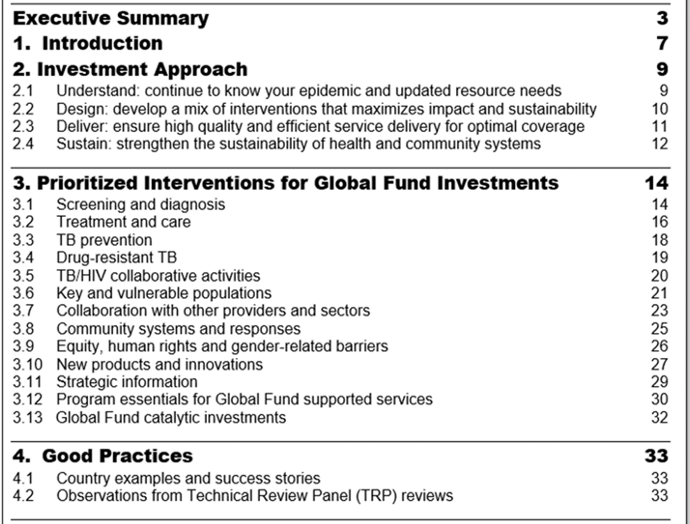
TB Information Note: Outline
Accessible at: https://www.theglobalfund.org/media/4762/core_tuberculosis_infonote_en.pdf

Slide 8
TB Prioritized Interventions for Global Fund Investments
The prioritized interventions listed in the TB Information Note are within the following areas:
1
Screening and Diagnosis
2
Treatment and Care
3
TB Prevention
4
Drug-resistant TB
5
Key and Vulnerable Populations
6
Collaboration With Other Providers and Sectors

Slide 9
TB Program Essentials (1/2)
1. TB Screening and Diagnosis | 1.1 Systematic TB screening is provided for those at highest risk (key and vulnerable population), including using chest X-rays, with or without computer aided detection (currently recommended for people aged 15 years and older). 1.2 Multiyear plan to achieve universal use of rapid molecular assays as the initial test to diagnose TB for all people with presumptive TB, with implementation on track. 1.3 All people with bacteriologically confirmed TB are tested for at least rifampicin resistance and for those with rifampicin-resistant TB further tests are conducted to rule out resistance to other drugs. 1.4 TB diagnostic network operates efficiently to increase access to testing and includes specimen transportation, maintenance of equipment, connectivity solutions, biosafety, quality assurance and supply system.
2. TB Treatment and Care | 2.1 Child friendly formulations, all oral regimens for drug-resistant TB, and 4-month regimen for non-severe, drug-susceptible TB are used for TB treatment in children. 2.2 People with DR-TB receive shorter, all oral regimens or individualized longer treatment regimens, as recommended by WHO.
3. TB Prevention | 3.1 TB preventive treatment (including shorter regimens) is available for all eligible people living with HV (adults and children) and for all eligible household contacts of people with bacteriologically confirmed pulmonary TB.

Slide 10
TB Program Essentials (2/2)
4. TB/HIV | 4.1 All people living with HIV with active TB are started on antiretroviral treatment early as per recommendations.
5. Cross-cutting Areas | 5.1 Establish, progressively scale-up and maintain a comprehensive, real-time, digital case-based TB surveillance systems. 5.2 Prioritized interventions are informed by cascade analysis throughout the pathway of TB care, including for TB preventive treatment. 5.3 Engagement of private healthcare providers is on a scale commensurate with their role in the healthcare system. 5.4 Decentralized, ambulatory, community- and home-based, people-centered services are provided across the continuum of TB care 5.5 All TB programming must be human rights-based, gender-responsive and informed by and respond to analysis of inequities; and include stigma and discrimination reduction activities for people with TB and TB-affected populations; legal literacy and access to justice activities; as well as support for community mobilization and advocacy and community-led monitoring for social accountability.

Slide 11
Innovations for scale up
 | Screening | Diagnosis | Treatment | Prevention
Objective | Systematic screening of high-risk groups. | Early diagnosis of all people with any form of TB (DS-TB and DR-TB). | Prompt initiation of, and adherence to appropriate treatment for all people with DS-TB and DR-TB. | Prevention and treatment of TB Infection.
Innovations and tools for inclusion in funding request. | Digital chest X-ray with or without CAD software TB antigen-based skin tests. | mWRD. LF-LAM for people living with HIV. LPA for first and second-line TB drugs. | All-oral DR-TB regimens, including 6-month regimens 4-month DS-TB regimen for children with non-severe TB. Pediatric FDCs and formulations for all forms of TB treatment. Digital adherence technologies. | New shorter, combination therapies (3HP, 1HP and 3HR).
Potential new products within the grant period |  | New LF-LAM technologies. Next generation mWRD. New sampling techniques (e.g., tongue swabs). |  | Pediatric formulations and FDCs of health product regimens.
Abbreviations used in the table: CAD: computer-aided detection; mWRD: molecular WHO-recommended rapid diagnostic tests; LF-LAM: lateral flow urine lipoarabinomannan assay; LPA: line probe assay; HP: Isoniazid and Rifapentine; HR: Isoniazid and Rifampicin

Slide 12
No | Standard | Policies/Guidelines | Implementation
1 | Systematic TB screening is provided for those at highest risk (key and vulnerable populations), including using Chest X-rays with or without computer-aided detection (currently recommended for people aged 15 years and older). | Yes | Implemented in some sites (<50%)
2 | Multiyear plan to achieve universal use of rapid molecular assays as the initial test to diagnose TB for all people with presumptive TB, with implementation on track. | Yes | Implemented in some sites (<50%)
3 | All people with bacteriologically confirmed TB are tested for at least rifampicin resistance and for those with RR-TB further tests are conducted to rule out resistance to other drugs. | Yes | Implemented in many sites (50%-95%)
4 | TB diagnostic network operates efficiently to increase access to testing and includes specimen transportation, maintenance of equipment, connectivity solutions, biosafety, quality assurance and supply system | Yes | Implemented in some sites (<50%)
5 | Child-friendly formulations, all-oral regimens for DR-TB, and 4-month regimen for non-severe, DS-TB are used for TB treatment in children. | Yes | Implemented countrywide (>95%)
6 | People with DR-TB receive shorter, all-oral regimens or individualized longer treatment regimens as recommended by WHO and people-centered support to complete their treatment. | Yes | Implemented countrywide (>95%)
7 | TB preventive treatment (including shorter regimens) is available for all eligible people living with HIV (adults and children) and for all eligible household contacts of people with bacteriologically confirmed pulmonary TB. | Yes | Implemented in some sites (<50%)
8 | All people living with HIV with active TB are started on ARV treatment early as per recommendations. | Yes | Implemented countrywide (>95%)
9 | Establish, progressively scale-up and maintain a comprehensive, real-time, digital case-based TB surveillance systems and ensure analysis and use of TB data for decision-making at all levels of TB services. | Yes | Implemented in some sites (<50%)
10 | Prioritized interventions are informed by cascade analysis throughout the pathway of TB care, including for TB preventive treatment | Yes | Implemented in many sites (50%-95%)
11 | Engagement of private health care providers is on a scale commensurate with their role in the provision of TB services. | Yes | Implemented in some sites (<50%)
12 | Decentralized, ambulatory, community- and home-based, people-centered services are provided across the continuum of TB care. | Yes | Implemented in many sites (50%-95%)
13 | All TB programming must be human rights-based, gender-responsive and informed by and respond to analysis of inequities; and include stigma and discrimination reduction activities for people with TB and TB-affected populations; legal literacy and access to justice activities; as well as support for community mobilization and advocacy and community-led monitoring for social accountability. | Yes | Implemented in many sites (50%-95%)
Notes:
Sample Essential Data Table for TB Program Essentials.

Slide 13
Potential approaches for addressing PE in GC7
Complete Essential Data Table (EDT) ready for country dialogue to focus discussions.
Can gaps identified to be addressed before the country dialogue process?
Can Technical Assistance needs identified (ahead of next funding cycle)?
Articulate next steps to optimize the current grant which will be ending in 2023.

Slide 14
Questions to consider for the PE activities within GC7
Given the current status (baseline assessment, national/international target), how would the country scale up in the next 3 years or to reach WHO/International recommended target for each of the Program Essentials?
What are the bottlenecks hindering the progressive scale up and how to overcome them in the next funding cycle.
What are some of the gap analyses/Technical Assistance that need to be undertaken ahead of the funding request development?
How will Zambia ensure Program Essentials are equitably implemented to all relevant populations throughout the country?
How would Zambia incorporate the Program Essential into routine activities (e.g., in supervision, training, registers, SOPs, updating guidelines)?
How can partners and other stakeholders support the implementation of the Program Essentials?
How will the TB Program Essentials be monitored?

Slide 15
Modular Framework: TB

Slide 16
TB Modules Allocation Periods 2020-2022 and 2023-2025
2020-2022 TB Modules
2023-2025 TB Modules
TB Care and Prevention.
TB/HIV.
Multidrug-resistant (MDR) TB.
Removing human rights and gender related barriers to TB services.
TB diagnosis, treatment and care.
Drug-resistant (DR-TB) diagnosis, treatment and care.
TB/HIV.
TB/DR-TB Prevention.
Key and vulnerable populations.
Collaboration with other providers and sectors.
Removing human and gender related barriers to TB services.

Slide 17
TB Modules and Interventions
Allocation Period 2023-2025
Revised modules/interventions
New modules
(new/recategorized interventions)
Module | Intervention
TB diagnosis, treatment and care | TB Screening and Diagnosis TB Treatment, Care and support
DR-TB diagnosis, treatment and care | DR-TB Diagnosis/ drug susceptibility testing (DST) DR-TB Treatment, Care and support
TB/HIV Care | TB/HIV Screening/testing TB/HIV Treatment, Care and support TB Prevention for people living with HIV (PLHIV) Community TB/HIV care delivery TB/HIV for Key and Vulnerable Populations (KVP) TB/HIV collaborative interventions
Removing human rights and gender related barriers to TB services | 9 interventions (4 new)
Module | Intervention
TB/DR-TB Prevention | Screening/testing for TB Infection Preventive treatment Infection Prevention and Control
Key and vulnerable populations | People in prisons/jails/detention centers Mobile population (migrants/refuges/internally displaced populations (IDPs)) Mining/mining communities Children and adolescent People with Co-morbidities Urban poor/slum dwellers Other KVP
Collaboration with other providers and sectors | Private provider engagement in TB/DR-TB care Community-based TB/DR-TB care Collaboration with other programs/sectors

Slide 18
Summary of TB indicator changes (2023-2025)
Alignment of the indicator codes with new TB module names
TCP = TBDT; MDR-TB = DR-TB. New codes: TBP (Prevention); TBC (Collaboration); KVP (TB/DR-TB Key and Vulnerable pops).
8 new indicators
Prevention (2), TB/HIV (1), Collaboration with other providers/sectors (1), DR-TB (4).
Indicators revisions with significant implications
DR-TB-9, TB O-4; TBDT-2, TB O-2a; DRTB-3 (formerly MDR TB-3); TB/HIV-7.1 (change from TB/HIV-7).
Minor revisions to the current indicators
(> 20 indicators)
Changes to indicator codes, some indicator definition text to align with global technical standards (mainly TB cases replaced by patients or people with TB), and disaggregation categories
Disaggregation categories
Review of the current TB MF disaggregation categories to identify gaps linked to certain indicators based on the relevance to the new Global Fund strategy, latest technical partner guidance, feasibility of data collection using existing systems and equity.

Slide 19
TB Matching Fund: Find and treat the missing people with DS-TB and DR-TB
Main Objective | Key Interventions
To find and successfully treat the missing people with DS-TB and DR-TB to improve TB treatment coverage and treatment success rate. | Catalyze early and accurate diagnosis through innovative approaches for TB screening (digital x-ray with CAD/AI software), universal use of rapid molecular diagnostics and drug-susceptibility testing for TB diagnosis, improved bacteriological confirmation of pulmonary TB. Systematic screening for TB in health facilities and through active case finding and outreach services (e.g., mobile clinics) targeting high risk groups. Accelerate scale up of innovative private sector engagement model, community- based services, and other specific focus areas relevant to the country context and agreed with country teams and partners. Scale up decentralized, ambulatory, and patient centered care for TB/DR-TB services including through primary health care approach and community support.

Slide 20
Overview of TB Resources

Slide 21
Key TB Resources for Funding Requests
Updates for the 2023-2025 Allocation Period
TB Information Note
The RSSH, HIV and Malaria Information Notes are also available here.
Additional Resources
1. Technical Briefs
Additional Technical Briefs to support applicants will be published in Q4 2022 on the Global Fund website.
2. Global Guidelines
All key technical guidance documents are in footnotes of the TB Information Note.
Modular Framework
This resources includes details on Global Fund-supported interventions and indicators.
Translations are in process for all Global Fund materials.
Notes:
The Global Fund has made available several resources that applicants should consult when developing their HIV funding request. These include
The HIV information Note
The Modular Framework (both of which I will talk to later in this presentation)
Other Information Notes (such as for RSSH) and Technical Briefs
This is in addition to the materials that are included on the Global Fund website with Applicant Guidance Materials.

Slide 22
Key Changes to TB-related materials
Updates for the 2023-2025 Allocation Period
Essential Data Tables
Alignment with new Global Fund Strategy, along with other global strategies and updated global guidelines
Includes information on Program Essentials (see slide xx), priority interventions and country examples
TB Information Note.
Streamlining of TB modules and interventions
New TB modules on key and vulnerable populations, collaboration with other providers and sectors.
Updated indicators aligned with Global Fund Strategy and WHO recommendations.
Modular Framework.
Additional baseline data (and disaggregates) which is pre-filled by Global Fund, where available.
Program Essentials table is to be completed by applicant.
Notes:
In the 2023-2025 allocation period, there are new opportunities to leverage advances in HIV
prevention and treatment and to adopt precision public health approaches. The new Global Fund and global strategies and guidelines spell out these opportunities which are also reflected in the HIV related guidance materials. These guidance materials have all been developed in collaboration with our key partners and they are fully aligned with HIV-related global strategies and the latest technical guidance. Regarding the Essential Data Tables, there are now 2 tables to complete, the indicator tables and the program essentials. The indicator tables are again pre-filled by Global Fund where available and now include additional baseline data (and disaggregates). I will speak about the key changes in the HIV information note and the modular framework as well as the program essentials later during my presentation. ​

Slide 23
TB Investment Approach
2.1 Understand
2.2 Design
Continue to know your epidemic and updated resource needs.
People-centered framework helps to facilitate systematic approach to country-led, people-centered planning & prioritization.
Tailored interventions are crucial to achieve impact in challenging operating environments (COEs). Global Fund’s Operational Policy Note on COE provides guidance on adaptive engagement.
Develop a mix of interventions that maximize impact and sustainability.
Value for money continues to be a key principle guiding Global Fund investments to maximize equitable health outcomes and impact. Refer to the Value for Money Technical Brief.
2.3 Deliver
2.4 Sustain
Ensure high quality and efficient service delivery for optimal coverage
Applicants are recommended to consider Protection from Sexual Exploitation, Abuse & Harassment (PSEAH) as well as child protection in planning & design of program interventions. PSEAH Guidance Note.
Strengthen the sustainability of health and community systems
Global Fund strongly encourages all countries to incorporate sustainability considerations throughout the grant life cycle.
Sustainability, Transition & Co-Financing (STC) Policy.
Notes:
Global Fund investments should contribute to country-owned responses. Therefore, requests should be aligned with national priorities set out in national strategic documents, specifically HIV National Strategic Plans which should be harmonized with national health sector strategies.
The HIV Investment approach outlines four stages of a strategic investment approach: understand, design, deliver, and sustain. Recommendations from the 2020-2022 Technical Review Panel (TRP) Lessons Learned Report are also reflected in this section.
Programs are at different stages in their response to the HIV epidemic. The recommendations provided in this section should be adapted to the country specific context. For example, while countries have been collecting data to know their epidemic, updated and increasingly more granular data will become necessary in some of those countries to address the evolving epidemic.

Slide 24
Annex

Slide 25
Annex
TB Indicators

Slide 26
Summary of TB Indicator Changes in the Next Cycle (1/4)
Alignment of the indicator codes with the new TB module names:
TCP = TBDT; MDR-TB = DR-TB.
New codes: TBP (Prevention); TBC (Collaboration); KVP (TB/DR-TB Key and Vulnerable Populations)
Eight new indicators
Prevention (2): TPT completion (%) and Contact investigation coverage (%) i.e., TBP-2 & 3
TB/HIV (1): Treatment Success Rate of HIV-positive TB patients i.e., TB/HIV-8
Collaboration with other providers/sectors (1): Treatment Success Rate in Private Sector (%) i.e., TBC-1
Drug resistant-TB diagnosis, treatment and care (4):
a) % of TB patients with DST result for Isoniazid among the total notified TB cases (DRTB-5)
b) % of RR/MDR-TB patients with DST results for Fluoroquinolone among the total notified RR/MDR-TB (DRTB-7)
c) % of Pre-XDR TB patients with DST results for Group A drugs other than fluoroquinolones among the total number of notified pre-XDR TB cases in the same year (DR TB-11)
d) Treatment Success Rate (TSR) for pre-XDR/XDR-TB i.e., DR TB-10

Slide 27
Summary of TB Indicator Changes in the Next Cycle (2/4)
Indicators revisions with significant implications:
DR-TB-9, TB O-4: Revision of the denominators for Treatment Success Rates for RR/MDR-TB indicators from the ‘total no. of bacteriologically confirmed patients enrolled on second-line anti-TB treatment’ to the ‘total no. of people with bacteriologically confirmed RR/MDR-TB notified during the year of assessment’. This is to align with global guidance and may have implications on target setting and indicator performance
TBDT-2, TB O-2a: Revision of the denominators for Treatment Success Rates for all forms of TB indicators from the ‘total no. of all forms of TB cases registered for treatment’ to the ‘total no. of people with all forms of TB notified in the same period’. This is to align with global guidance and may have implications on target setting and indicator performance
DRTB-3 (formerly MDR TB-3): Change from number (#) of to ‘percentage (%) of people with confirmed RR-TB and/or MDR-TB that began second-line treatment’. This indicator now has a N and D.
Numerator: No. of people with bact. confirmed RR-TB and/or MDR-TB registered and started on second-line treatment regimen
Denominator: Total no. of people with bact. confirmed RR-TB and/or MDR-TB notified during the period of assessment

Slide 28
Summary of TB Indicator Changes in the Next Cycle (3/4)
TB/HIV-7.1 (change from TB/HIV-7)
The new ‘TPT for PLHIV currently enrolled on ART’ indicator is one of the two TPT for PLHIV indicators to be reported through the UNAIDS GAM system and by WHO (TB).
To correctly calculate the denominator, the ‘Total no. of PLHIV currently enrolled on ART who started TPT prior to the reporting period’(proxy for eligibility) should be subtracted from the ‘total no. of PLHIV currently enrolled on ART’. This requires countries to also have historical data available in their data systems on the # of PLHIV who received TPT prior to the reporting period. Currently, not all countries have data systems with information on the Total no. of PLHIV currently enrolled on ART who started TPT prior to the reporting period.
When reporting to the Global Fund, PRs would need to include a comment in the PUDR to indicate whether the country data system is able to correctly calculate the denominator and if this was used in calculating the denominator or not.
At the same time, countries are encouraged to continue to strengthen their data systems to be able to correctly report the TB/HIV-7.1 indicator
Indicator | Indicator description | Numerator | Denominator
TB/HIV-7 (previous) | % of PLHIV on ART who initiated TB preventive therapy among those eligible during the reporting period | PLHIV on ART who initiated TB preventive therapy (TPT) during the reporting period (#) | PLHIV on ART who are eligible for TPT during the same reporting period (#)
TB/HIV-7.1 (new) | % of PLHIV currently enrolled on ART who started TB preventive treatment (TPT) during the reporting period | Total number of PLHIV currently enrolled on antiretroviral therapy who started TPT during the reporting period | Total number of PLHIV currently enrolled on antiretroviral therapy
Notes:
TB/HIV-7.1: The PUDR comment approach aims to address the need for uniformity with the WHO indicator definitions, the gap in WHO guidance on repeat TPT for PLHIV and the challenge some countries have in being able to calculate and report this indicator denominator correctly

Slide 29
Summary of TB Indicator Changes in the Next Cycle (4/4)
Minor revisions to the current indicators (> 20 indicators): changes to indicator codes, some indicator definition text to align with global technical standards (mainly TB cases replaced by patients or people with TB), and disaggregation categories.
Disaggregation categories: Review of the current TB MF disaggregation categories to identify gaps linked to certain indicators based on the relevance to the new Global Fund strategy, latest technical partner guidance, Feasibility of data collection using existing systems and equity. e.g., Bact. confirmed, type of TPT and DR-TB regimens, HIV status, type of provider, age & gender​
New disaggregation categories included for seven TB indicators​ for the 2023-2025 allocation period.
Disaggregation categories dropped for 4 indicators.
Notes:
Disaggregation categories dropped for 4 indicators (disaggregated data is relevant at country-level but deemed not required for reporting to Global Fund)​

Slide 30
List of TB Modular/Performance Framework indicators (2023 – 2025 cycle) – 1/2
Total no. of indicators 39 (4 impact, 7 outcome, 28 coverage indicators)
Module | Type of Indicator | Indicator Description
Impact indicators (All modules) | Impact | TB incidence rate per 100,000 population
 | Impact | TB mortality rate per 100,000 population
 | Impact | RR-TB and/or MDR-TB prevalence among new TB patients: Proportion of new TB patients with RR-TB and/or MDR-TB
 | Impact | TB/HIV mortality rate per 100,000 population
Outcome indicators (All modules) | Outcome | Treatment success rate of all forms of TB - bacteriologically confirmed plus clinically diagnosed, *includes only those with new and relapse TB
 | Outcome | Treatment success rate of RR TB and/or MDR-TB: Percentage of patients with RR and/or MDR-TB successfully treated
 | Outcome | TB treatment coverage: Percentage of patients with new and relapse TB that were notified and treated among the estimated number of incident TB in the same year (all form of TB - bacteriologically confirmed plus clinically diagnosed)
 | Outcome | Treatment coverage of RR-TB and/or MDR-TB: Percentage of notified people with bacteriologically confirmed, drug resistant RR-TB and/or MDR-TB as a proportion of all estimated people with RR-TB and/or MDR-TB
 | Outcome | Percentage of people diagnosed with TB who experienced self-stigma that inhibited them from seeking and accessing TB services
 | Outcome | Percentage of people diagnosed with TB who report stigma in health care settings that inhibited them from seeking and accessing TB services
 | Outcome | Percentage of people diagnosed with TB who report stigma in community settings that inhibited them from seeking and accessing TB services
TB diagnosis, treatment and care | Coverage | Number of patients with all forms of TB notified (i.e. bacteriologically confirmed + clinically diagnosed), *Includes only those with new and relapse TB
 | Coverage | Treatment success rate- all forms: Percentage of people with TB, all forms, bacteriologically confirmed plus clinically diagnosed, successfully treated (cured plus treatment completed) among all TB patients notified during a specified period, *includes only those with new and relapse
 | Coverage | Percentage of notified patients with all forms of TB (i.e. bacteriologically confirmed + clinically diagnosed) contributed by non-national TB program providers – private/non-governmental facilities;*Includes only those with new and relapse TB
 | Coverage | Percentage of notified patients with all forms of TB (i.e. bacteriologically confirmed + clinically diagnosed) contributed by non-national TB program providers – public sector; *Includes only those with new and relapse TB
 | Coverage | Percentage of notified patients with all forms of TB (i.e. bacteriologically confirmed + clinically diagnosed) contributed by non-national TB program providers – community referrals; *Includes only those with new and relapse TB
 | Coverage | Percentage of new and relapse TB patients tested using WHO recommended rapid diagnostic tests at the time of diagnosis
TB/DR-TB Prevention | Coverage | Number of people in contact with TB patients who began preventive therapy
 | Coverage | Percentage of people who completed TPT out of those who initiated TB Preventive Treatment
 | Coverage | Contact investigation coverage: Proportion of contacts of people with bacteriologically-confirmed TB evaluated for TB among those eligible

Slide 31
List of TB Modular/Performance Framework indicators (2023 – 2025 cycle) – 2/2
Module | Type of Indicator | Indicator Description
TB/HIV | Coverage | Percentage of registered new and relapse TB patients with documented HIV status
 | Coverage | Percentage of HIV-positive new and relapse TB patients on ART during TB treatment
 | Coverage | Percentage of people living with HIV newly initiated on ART who are screened for TB
 | Coverage | Percentage of people living with HIV currently enrolled on antiretroviral therapy who started TB preventive treatment (TPT) during the reporting period
 | Coverage | Treatment Success Rate (TSR) for HIV-positive TB patients - % of HIV-positive TB patients, all forms, bacteriologically confirmed plus clinically diagnosed successfully treated among all HIV-positive TB cases registered for treatment during a specified period, *includes only those with new and relapse TB
DR-TB diagnosis, treatment and care | Coverage | Percentage of TB patients with DST result for at least Rifampicin among the total number of notified (new and retreatment) patients during the reporting period
 | Coverage | Number of people with confirmed RR-TB and/or MDR-TB notified
 | Coverage | Percentage of people with confirmed RR-TB and/or MDR-TB that began second-line treatment
 | Coverage | Percentage of people with RR-TB/MDR-TB who did not start treatment and/or started on treatment for MDR-TB who were lost to follow up during the first six months of treatment
 | Coverage | Percentage of DST laboratories showing adequate performance on External Quality Assurance
 | Coverage | Number of people with pre-XDR/XDR TB enrolled on treatment
 | Coverage | Treatment success rate of RR TB and/or MDR-TB: Percentage of patients with RR and/or MDR-TB successfully treated
 | Coverage | Treatment Success Rate (TSR) for pre-XDR/XDR-TB: % of bacteriologically-confirmed pre-XDR/XDR-TB patients enrolled on treatment successfully treated
 | Coverage | Percentage of TB patients with DST result for Isoniazid among the total number of notified people with TB (new and retreatment) in the same year
 | Coverage | Percentage of Pre-XDR TB patients with DST results for Group A drugs other than fluoroquinolones among the total number of notified Pre-XDR TB patients (new and retreatment) in the same year
 | Coverage | Percentage of RR/MDR-TB patients with DST results for Fluoroquinolone among the total number of notified RR/MDR-TB patients in the same year
Key and vulnerable populations – TB/DR-TB | Coverage | Number of people with TB (all forms) notified among prisoners; *includes only those with new and relapse TB
 | Coverage | Number of people with TB (all forms) notified among key affected populations/ high risk groups (other than prisoners); *includes only those with new and relapse TB
Collaboration with other providers and sectors | Coverage | Treatment Success Rate (TSR) in private sector - % of TB patients, all forms, bacteriologically confirmed plus clinically diagnosed, successfully treated in the private sector

Slide 32
Annex
Priority Interventions for Global Fund Investments

Slide 33
TB Prioritized Interventions for Global Fund Investments
Screening and Diagnosis
Testing non-sputum-based samples of children, improving bacteriological confirmation of pulmonary TB, and universal rapid drug-susceptibility testing (DST) are also priorities.
Diagnostic network strengthening to address the gaps that limit access to and utilization of diagnostic services.
Integrated testing for TB with other diseases such as dual (bidirectional) testing for TB and SARS-CoV-2 should be considered in populations at risk for both diseases.
Plans to scale up and improve the quality of systematic screening by using more sensitive digital chest X-rays and computer-aided detection (CAD) software.
The use of molecular WHO-recommended rapid diagnostics, as the initial diagnostic test to replace sputum microscopy.
Expanding testing for TB infection.
Decentralizing services across the care cascade.

Slide 34
TB Prioritized Interventions for Global Fund Investments
Treatment and Care
Shorter and more patient-friendly treatment regimens for drug-susceptible TB (DS-TB).
Pediatric fixed-dose combination formulations for children with TB.
Shorter, safer, injection-free and all-oral treatment regimens for drug-resistant TB (DR-TB) from the start of treatment.
Shift to decentralized, ambulatory, community and home-based services.
To better enable treatment adherence, it is important to: (1) monitoring and management of adverse drug reactions; (2) management of existing conditions and co-morbidities; and (3) psychosocial and nutritional support for key and vulnerable populations, including through linkages to broader social protection services.
Scaling up digital tools for treatment adherence.
This technical brief developed by the Global DAT Task Force includes:
Overview of the technologies
Guidance to applicants on planning, budgeting, and implementation considerations.

Slide 35
TB Prioritized Interventions for Global Fund Investments
TB Prevention
Rapid scale-up of screening and evaluation of all household contacts, people living with HIV and other key and vulnerable populations with high-risk for TB infection.
Improving access to TB infection testing.
Increasing the coverage and adherence to TB preventive treatment.
Strengthening completeness and accuracy of TPT data, and monitoring performance.
Activities to promote TB preventive treatment (TPT) should be integrated with ongoing activities as a continuum of care, such as in finding people eligible for TPT as a part of active TB case finding and contact investigations.
To generate demand and improve acceptability of TPT, countries are encouraged to address provider and recipient hesitancy, provide shorter regimens for TPT and support for treatment completion.

Slide 36
TB Prioritized Interventions for Global Fund Investments
Drug-resistant TB
Early detection of drug-resistance, including using rapid molecular diagnostics and drug susceptibility testing (DST) such as GeneXpert, TrueNat, line probe assay (LPA) for first and second-line drugs.
Decentralize testing and treatment services, with preference for ambulatory care from treatment initiation instead of hospitalization.
Scale up the use of WHO recommended shorter, safer, all-oral treatment regimens for DR-TB (including pre-XDR* and XDR-TB*) at the start of treatment and rapidly phase out the use of injection-based regimens
Consider transitioning to the shorter, novel 6-month all-oral regimens (BPaLM* or BPaL*) and the 9-month all-oral bedaquiline-containing regimens following WHO recommendations.
*XDR: Extensively Drug-resistant TB; BPaL: Bedaquiline, Pretomanid and Linezolid; BPaLM: Bedaquiline, Pretomanid, Linezolid and Moxifloxacin

Slide 37
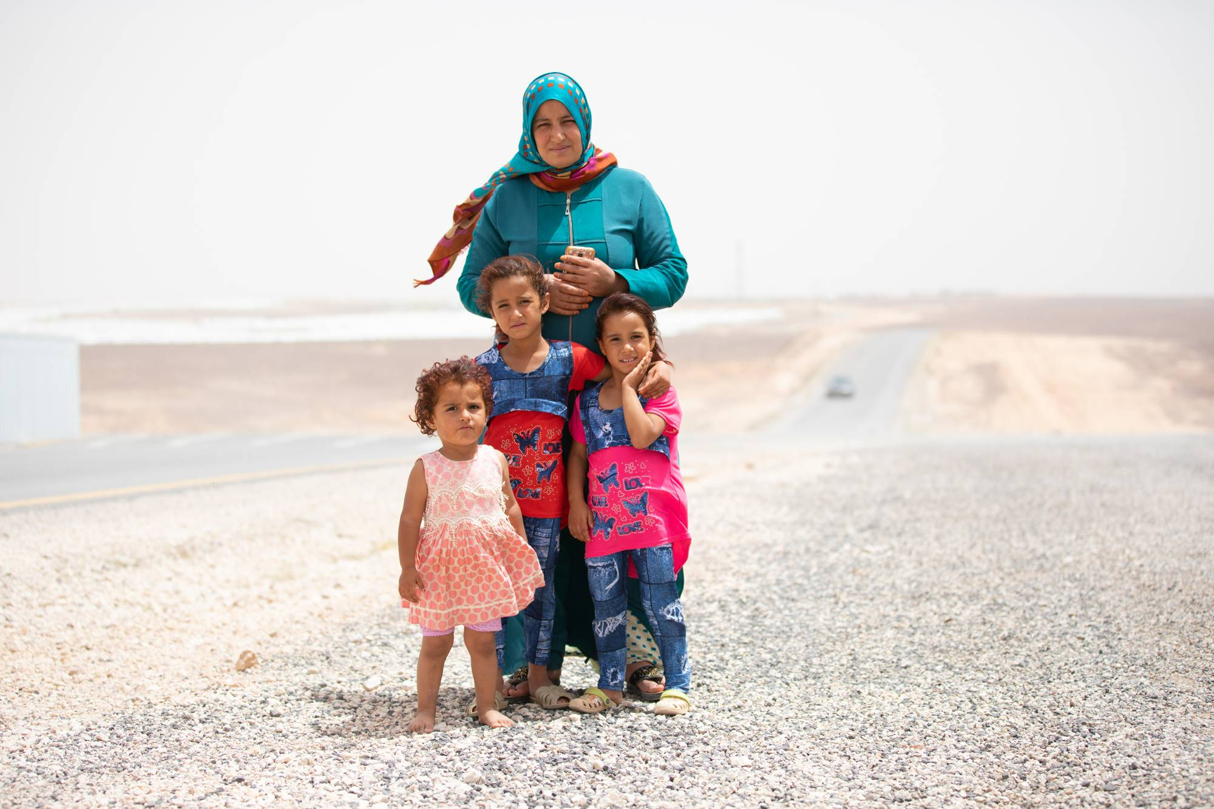
TB Prioritized Interventions for Global Fund Investments
Key and Vulnerable Populations
Understand the size, location and special needs of key and vulnerable populations in the country.
Remove barriers to TB services for key and vulnerable populations.
Consider cross-border policies, legal framework and interventions to facilitate continuum of TB care services in countries with high cross-border movement of people.
Train health care workers on infection prevention and control and provide them with access to a safe working environment, which includes adequate supplies of personal protective equipment, regular screening for TB, and support for treatment completion.
Source: Stop TB Partnership

Slide 38
TB Prioritized Interventions for Global Fund Investments
Key & Vulnerable Populations
People who have increased exposure to TB due to where they live or work | Prisoners, miners, hospital visitors, health care workers and community health workers. People who: • live in urban slums. • live in poorly ventilated or dusty conditions. • are in contact with TB patients, especially children. • work in overcrowded environments. • work in hospitals or health care settings.
People who have limited access to quality TB services | Migrant workers, women in settings with gender disparity, children, migrants, refugees or internally displaced people, and illegal miners. People who: • are from tribal populations or indigenous groups. • are homeless. • live in hard-to-reach areas. • live in homes for the elderly. • have mental or physical disabilities. • face legal barriers to access care.
People at increased risk of TB because of biological or behavioral factors that compromise immune function | People who: • live with HIV. • have diabetes or silicosis. • undergo immunosuppressive therapy. • are undernourished. • use tobacco. • suffer from alcohol-use disorder. • inject drugs.
Source: Stop TB Partnership

Slide 39
TB Prioritized Interventions for Global Fund Investments
Collaboration With Other Providers and Sectors
1
Identify all people who have TB and ensure they receive quality and comprehensive care, national TB programs (NTP) must work in collaboration with partners.
2
Engaging with private health care providers, non-NTP public health care providers is important in countries where they serve as the first point of care for a large proportion of people with TB.
3
Innovative private sector engagement models, including contracting, result-based payments and use of intermediary agencies.
Strengthen collaboration with health programs for effective integrated service delivery and/or referral linkages to address coinfection and comorbidities. This includes Reproductive, Maternal, Newborn, Child and Adolescent Health (RMNCAH), mental health and non-communicable diseases (NCD) disease programs.
4
Support approaches to address catastrophic costs due to TB, in line with national policies. Collaborate with relevant ministries, departments and agencies, to include TB services and support as part of universal health coverage packages, social protection schemes.
5
Notes:
The Secretariat has developed the C19RM M&E framework (including indicators to track progress) to ensure consistent reporting of investments and progress in C19RM across countries.

Slide 40
TB/HIV collaborative activities
Community systems responses
HIV-positive people should be offered antiretroviral treatment and cotrimoxazole prophylaxis. Similarly, people living with HIV should be offered screening for TB at each contact with health care providers.
Those with active TB disease should be started on TB treatment, while those without the disease who are eligible for TPT should be offered and initiated on TPT.
Screening algorithms should be aligned to WHO recommendations and should consider the use chest X-rays (with or without CAD), C-reactive Protein, LF-LAM test, and mWRD.
Strengthen the institutional capacity and leadership of TB community-based and led organizations and networks of TB survivors to facilitate their participation in national TB governance and decision-making processes
Scale up effective and quality community-led and community-based service delivery to improve access to quality TB services, while improving the sustainability of these interventions via public financing (social contracting).
Support community-based and led interventions and outreach services for TB screening, diagnosis, treatment and care, TB prevention, and rehabilitation
Community Systems Strengthening Technical Brief.

Slide 41
Equity, human rights and gender-related barriers
Strategic
Information
Eliminate TB related stigma and discrimination.
Ensure people-centered and rights-based TB services at health facilities and law enforcement practices
Promote legal literacy (“Know your rights”).
Increase access to justice.
Monitor and reform policies, regulations and laws.
Reduce TB-related gender discrimination, harmful gender norms and violence.
Refer to TB and Human Rights Technical Brief, upcoming implementer’s guide on human rights, gender and equity and analysis of 20 national TB community, rights and gender (CRG) assessments.
Strengthen TB surveillance systems, innovations in TB care
Deploy real-time, digital case-based TB disease surveillance systems that inform decision-making and actions at all levels of services is an urgent priority.
Use disaggregated data at least by age, sex, place of residence along with socio-economic status and key and vulnerable populations groups where possible, to allow for better understanding of the disease burden and gaps in service delivery to inform differentiated response.
Strengthen private sector, community health services and community led monitoring data reporting and quality assurance, integrated in the national TB program and HMIS.

Slide 42
TRP Observations: TB General
2020-2022 TRP Observations Report.
Many TB programs maximized synergies with COVID-19 through bi-directional screenings, digital tools for treatment adherence, accelerating existing tools and innovations such as GeneXpert and computer-aided diagnosis, and deploying TB community members trained to also respond to COVID-19.
The TRP appreciated that there was a TB cascade analysis in most funding requests and gradual improvement of TB diagnostic and treatment services. While funding requests showed increased prioritization of policies and guidance on TB prevention, the TRP is concerned that implementation of TB preventative treatment (TPT), especially shorter regimens, remains low.
Applicants are encouraged to access more support to plan and implement interventions to prevent TB, and to diagnose and retain key and vulnerable populations in treatment and care, using detailed situational and data-driven analysis.
Data and approaches for pediatric TB also need more attention, including availability and use of pediatric TB treatment, healthcare worker training to identify pediatric TB, robust contact investigations that include children and widespread adoption of TPT.
Concerned that relatively few civil society and community-led TB organizations are mentioned in the development of TB funding requests and/or implementation. Community mobilization requires more investment, with greater attention to community health workers (CHWs) for TB and community health activities.

